Slide 1
Modeling Scientific Impact with Topical Influence Regression
James Foulds Padhraic Smyth
Department of Computer Science
University of California, Irvine

Slide 2
Exploring a New Scientific Area

Slide 3
Exploring a New Scientific Area
Which are the most important articles?

Slide 4
Exploring a New Scientific Area
What are the influence relationships between articles?

Slide 5
Outline
Background: Modeling scientific impact, topic models
Metric: Topical Influence
Model: Topical Influence Regression
Inference Algorithm
Experimental Results

Slide 6
Can’t We Just Use Citation Counts?
Many citations are made out of “politeness, policy or piety” [Ziman, 1968].
Article (A)
Article (B)
Built upon the ideas of (B)
Mentioned (A) in passing
Which article is more influential?

Slide 7
Enter: Natural Language Processing
Use NLP techniques to exploit textual information in conjunction with citation information
Using this extra information, we should be able to gain a deeper understanding of scientific impact than simple citation counts

Slide 8
Previous Approaches
Traditional Bibliometrics
Citation counts, journal impact factors, H-Index
Graph-based
PageRank on the citation graph
PageRank on an article similarity graph (Lin, 2008)
Supervised Machine Learning
Classifying citation function (Teufel et al., 2006)
NLP / Topic Models
Dietz et al. (2007), Gerrish & Blei (2010),
Nallapati et al. (2011) …

Slide 9
Our Approach
A metric arising from a generative probabilistic model for scientific corpora
Fully unsupervised
Exploits both textual content and the
citation graph
Recovers both node-level and edge-level influence scores
A flexible, extensible regression framework

Slide 10
Latent Dirichlet Allocation Topic Models
Topic models are a bag of words approach to modeling text corpora
Topics are distributions over words
Every document has a distribution over topics, with a Dirichlet prior
Every word is assigned a latent topic, which it is assumed to be drawn from.

Slide 11
Latent Dirichlet Allocation and Polya Urns
For each document
Place colored balls in that document’s urn, where each color is associated with a topic, and α is the Dirichlet prior on the distribution over topics.
For each word
Draw a ball from the urn, observe its color k
Draw the word token from topic k
Place the ball back, along with a new ball of the same color

Slide 12
A New Metric: Topical Influence
Intuition: the topical influence l^{(a)} of article a is the extent to which it coerces the documents which cite it to have
similar topics to it.
Citations
Influence

Slide 13
Topical Influence Regression
Parameters vector for the Dirichlet prior on the distribution over topics of article a
Set of articles that a cites
The non-negative scalar topical influence weight for article a
Normalized histogram of topic counts

Slide 14
Topical Influence
Each article a has a collection of colored balls distributed according to its topic assignments
Article a
Article b

Slide 15
Topical Influence
Each article a has a collection of colored balls distributed according to its topic assignments
It places copies of these balls into the urn for the prior of each article that cites it
Article a
Article b
Article a
Article b
Article c
Article d
Article e

Slide 16
Topical Influence
Each article a has a collection of colored balls distributed according to its topic assignments
It places copies of these balls into the urn for the prior of each document that cites it
Article a
Article b
Article a
Article b
Article c
Article d
Article e

Slide 17
Topical Influence
Each article a has a collection of colored balls distributed according to its topic assignments
It places copies of these balls into the urn for the prior of each document that cites it
Article a
Article b
Article a
Article b
Article c
Article d
Article e

Slide 18
Topical Influence
Each article a has a collection of colored balls distributed according to its topic assignments
It places copies of these balls into the urn for the prior of each document that cites it
Article a
Article b
Article a
Article b
Article c
Article d
Article e

Slide 19
Topical Influence
The topical influence weight specifies how many balls article a puts into each citing document’s urn (possibly fractional)
l^{(a)} = 5
l^{(b)} = 5

Slide 20
Topical Influence
The topical influence weight specifies how many balls article a puts into each citing document’s urn (possibly fractional)
l^{(a)} = 10
l^{(b)} = 5

Slide 21
Total Topical Influence
Total topical influence T^{(a)} is defined to be the total number of balls article a adds to the other articles’ urns
T^{(a)} = 20
T^{(b)} = 10
l^{(a)} = 10
l^{(b)} = 5

Slide 22
Topical Influence Regression for Edge-level Influence Weights
We can extend the model to handle differing influence weights on citation edges:

Slide 23
Topical Influence Regression for Edge-level Influence Weights
We can extend the model to handle differing influence weights on citation edges:

Slide 24
Inference
Collapsed Gibbs sampler
Interleave gradient updates for the influence variables (stochastic EM)

Slide 25
Inference – Collapsed Gibbs Sampler
Usual LDA update, but with topical influence prior

Slide 26
Inference – Collapsed Gibbs Sampler
Usual LDA update, but with topical influence prior
Likelihood for a Polya urn distribution.

Slide 27
Experiments
Two corpora of scientific articles were used
ACL (1987-2011), 3286 articles
NIPS (1987-1999), 1740 articles
Only citations within the corpora were considered
Model validation using metadata
Held-out log-likelihood
Qualitative analysis

Slide 28
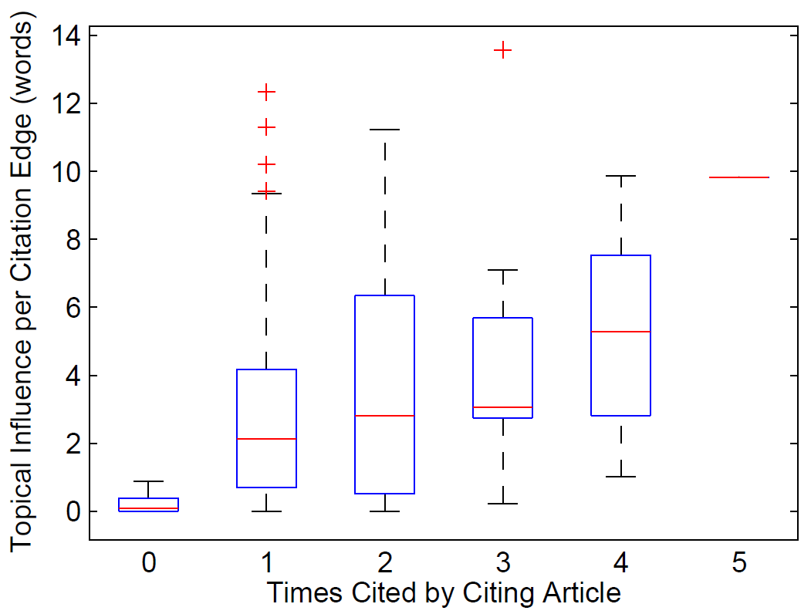
Model Validation Using Metadata: Number of times the citation occurs in the text

Slide 29
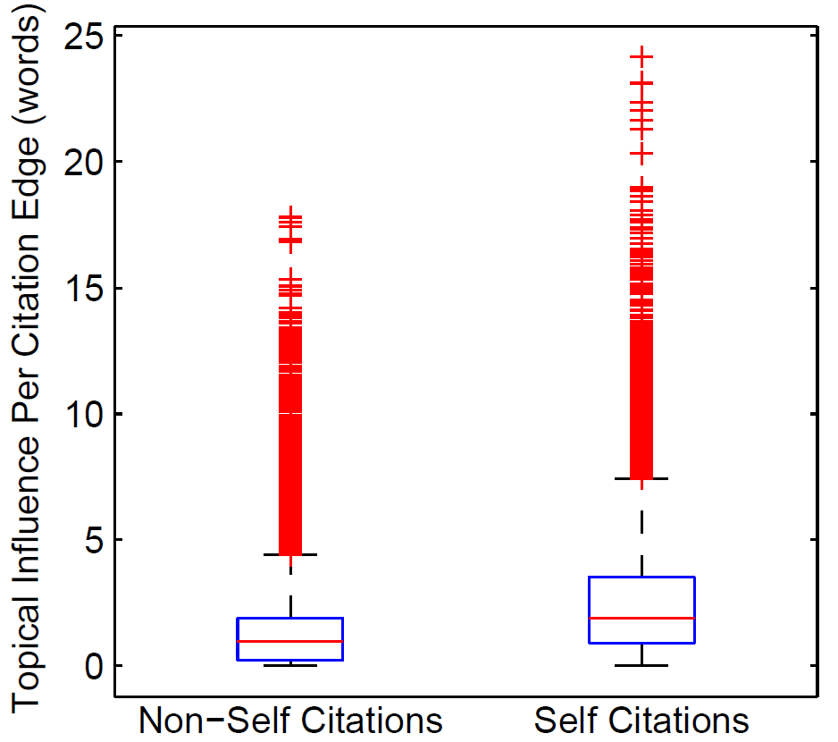
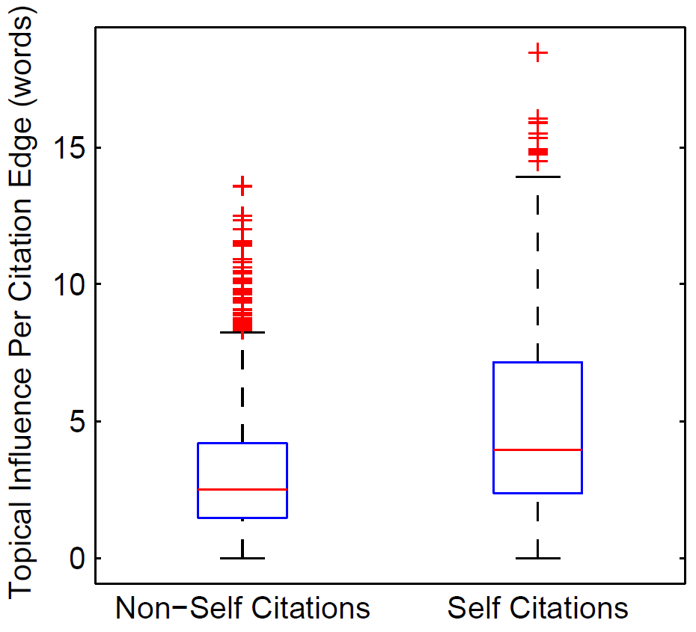
Self citations
ACL Corpus
NIPS Corpus

Slide 30
Log-Likelihood on Held-Out Documents vs LDA
 | ACL |  |  | NIPS
 | Wins | Losses | Average Improvement | Wins | Losses | Average Improvement
TIR | 297 | 33 | 65.7 | 150 | 20 | 38.2
TIRE | 276 | 54 | 63.0 | 148 | 22 | 38.7

Slide 31
Log-Likelihood on Held-Out Documents vs LDA
 | ACL |  |  | NIPS
 | Wins | Losses | Average Improvement | Wins | Losses | Average Improvement
TIR | 297 | 33 | 65.7 | 150 | 20 | 38.2
TIRE | 276 | 54 | 63.0 | 148 | 22 | 38.7
DMR | 302 | 28 | 79.1 | 157 | 13 | 48.4

Slide 32
Results: Most Influential ACL Articles

Slide 33
Results: Most Influential ACL Articles
ACL Best Paper Award, 2005
Down to 5th place, from 1st by citation count

Slide 34
Results: Most Influential NIPS Articles

Slide 35
Results: Most Influential NIPS Articles
Down to 13th place, from 1st by citation count
Seminal papers

Slide 36
Results: Edge Influences, ACL
Discriminative Training and Maximum Entropy Models for Statistical Machine Translation. F. Och and H. Ney.
Toward Smaller, Faster, and Better Hierarchical Phrase-based SMT.
M. Yang, J. Zheng.
1.48
2.54
A Hierarchical Phrase-Based Model for Statistical Machine Translation.
D. Chiang.
0.60
0.00
An Optimal-time Binarization Algorithm for Linear Context-Free Rewriting Systems with Fan-out Two.
C. Gomez-Rodriguez, G. Satta.
BLEU: a Method for Automatic Evaluation of Machine Translation.
K. Papineni, S. Roukos, T. Ward, W. Zhu.

Slide 37
Results: Edge Influences, ACL
Discriminative Training and Maximum Entropy Models for Statistical Machine Translation. F. Och and H. Ney.
Toward Smaller, Faster, and Better Hierarchical Phrase-based SMT.
M. Yang, J. Zheng.
1.48
2.54
Builds upon
the method
Related SMT paper
A Hierarchical Phrase-Based Model for Statistical Machine Translation.
D. Chiang.
BLEU evaluation
technique
Not related
0.60
0.00
An Optimal-time Binarization Algorithm for Linear Context-Free Rewriting Systems with Fan-out Two.
C. Gomez-Rodriguez, G. Satta.
BLEU: a Method for Automatic Evaluation of Machine Translation.
K. Papineni, S. Roukos, T. Ward, W. Zhu.

Slide 38
Results: Edge Influences, NIPS
The Parti-Game Algorithm for Variable Resolution Reinforcement Learning in Multidimensional State-Spaces. A. Moore.
Memory-based Reinforcement Learning: Efficient Computation with Prioritized Sweeping. A. Moore, C. Atkeson.
5.47
3.36
Feudal Reinforcement Learning.
P. Dayan, G. Hinton
1.71
0.00
Multi-time Models for Temporally Abstract Planning. D. Precup, R. Sutton.
A Delay-Line Based Motion Detection Chip. T. Horiuchi, J. Lazzaro, A. Moore, C. Koch.

Slide 39
Results: Edge Influences, NIPS
The Parti-Game Algorithm for Variable Resolution Reinforcement Learning in Multidimensional State-Spaces. A. Moore.
Memory-based Reinforcement Learning: Efficient Computation with Prioritized Sweeping. A. Moore, C. Atkeson.
5.47
3.36
Feudal Reinforcement Learning.
P. Dayan, G. Hinton
Irrelevant
Less relevant
1.71
0.00
Multi-time Models for Temporally Abstract Planning. D. Precup, R. Sutton.
A Delay-Line Based Motion Detection Chip. T. Horiuchi, J. Lazzaro, A. Moore, C. Koch.

Slide 40
Conclusions / Future Work
Topical Influence is a quantitative measure of scientific impact which exploits the content of the articles as well as the citation graph
Topical Influence Regression can be used to infer topical influence, per article and per citation edge
Future work
Authors, journals
Citation context
Temporal dynamics
Application to social media
Other dimensions of scientific importance

Slide 41
Thanks!
Questions?

